Slide 1
Predictive analysis prototype for Shipment delays
Internship Project by Minal Raghu PES University

Slide 2

Abstract
Project details
Project results
Learning outcomes
Conclusion
Acknowledgement
Quote ☺

Slide 3


Predictive analysis using Machine Learning and Power BI
ABSTRACT
Task – To develop a prototype that can make predictions on shipment delays by an LSP (Logistic Service Provider) for a particular Origin and Destination Cities.
Tools Used – Microsoft Power BI, Python

Slide 4
Overview and Scope
PROJECT DETAILS
Travis2.0 is a cloud-based transport management system.
The visualizations for Travis is done in DCT (digital control tower) which uses Microsoft Power BI as the Front End.
This prototype is helpful in bringing predictive analysis for Travis which is visualized in Power BI.
The prototype can be further enhanced according to the requirements of DCT.

Slide 5
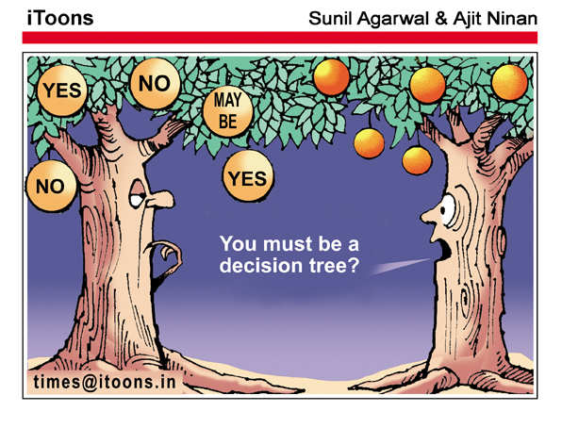
Algorithm
PROJECT DETAILS
DECISION TREE CLASSIFIER
Supervised Machine Learning Model
Widely used in predictive analysis projects.
WHY?
1. Easy to implement
2. Most efficient in making predictions.

Slide 6
Concept Approach
PROJECT DETAILS
DATA PRE-PROCESSING
The following steps have been automated in Power BI.
Structuring the unstructured data
Data cleansing which includes removing Null values, changing dtypes.
Delay calculation = (eta – deliveryDate)
Where, eta is estimated date and deliveryDate is actual date.
Conditional column for labelling the delay values.
Label encoding – Process of converting text into numeric values that can be read by the machine.
MODEL TRAINING
Decision tree algorithm is used for the training and predictions
Simple UI has been designed for a good user experience.

Slide 7
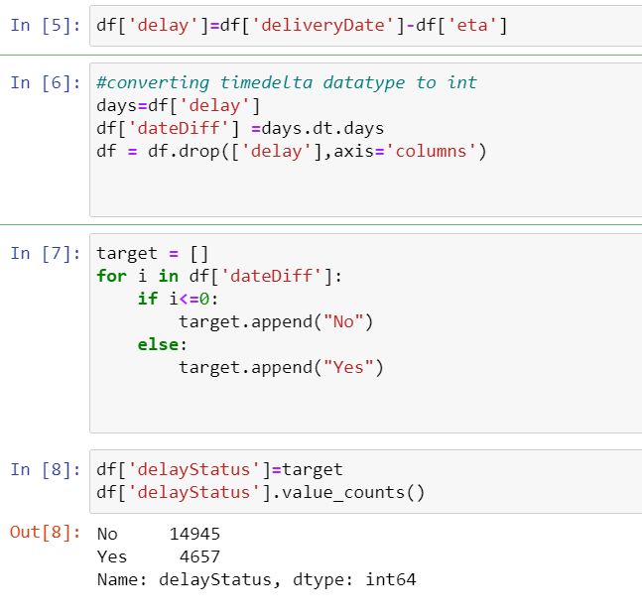
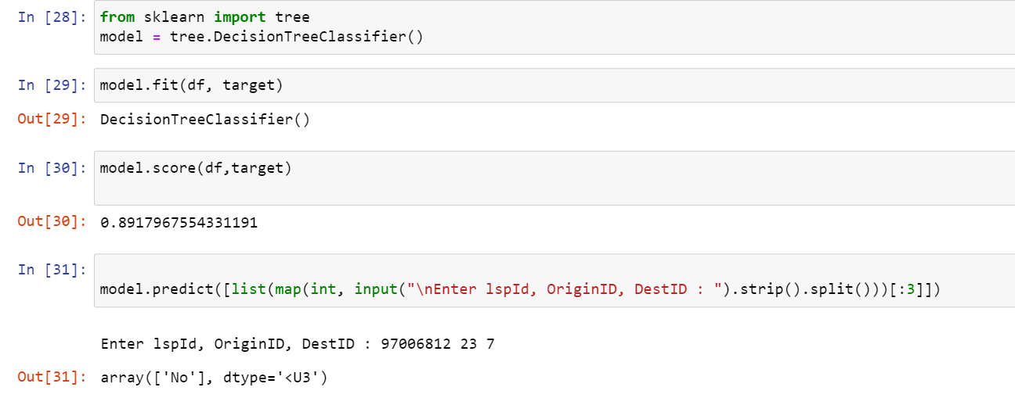
Initial Work
PROJECT DETAILS
Understanding requirements
Getting Familiar with Power BI
Jupyter Notebook for initial implementations
Insights of Supply Chain Management, Travis and other projects of DT
Meeting new people

Slide 8
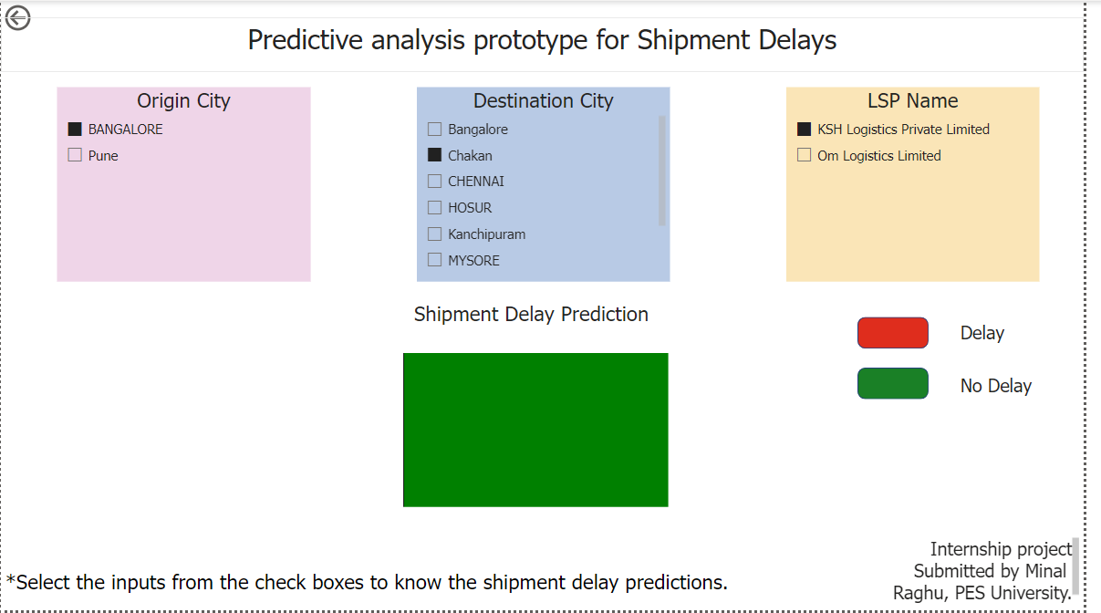
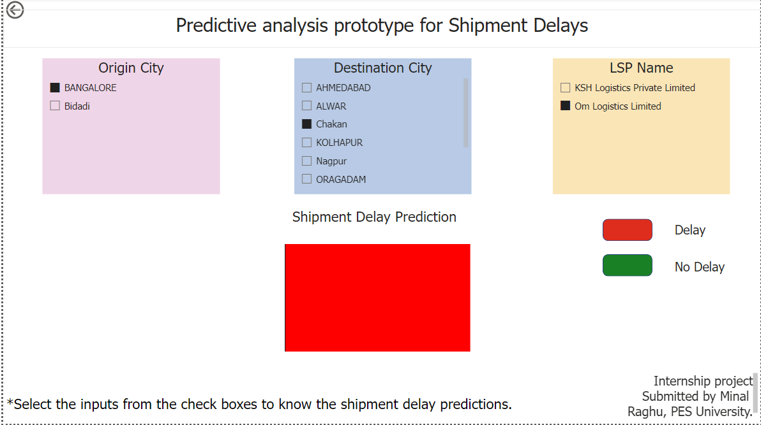
Output
PROJECT RESULT
NO DELAY
DELAY

Slide 9
UI Features
PROJECT RESULT
Simple and Easy to use
Minimalistic design
Slicers (check boxes) for user inputs
Colors red and green indicating the output result
Slicers automatically update:
For the selected Origin, it shows the available destinations and LSP available for that route, Vice versa.

Slide 10
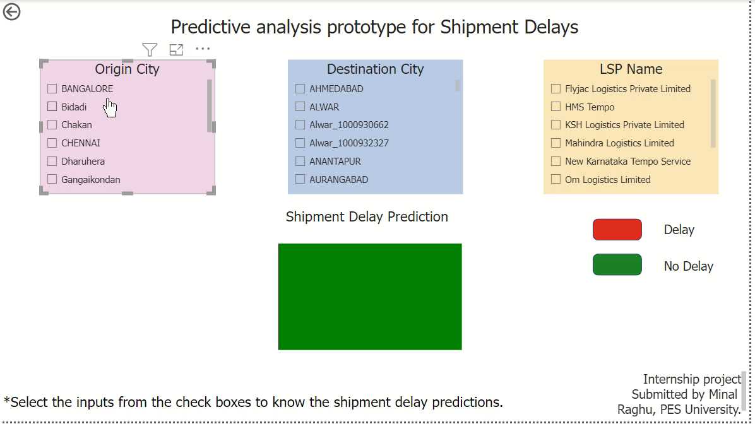
Implementation
PROJECT RESULT

Slide 11
Future Scope
PROJECT RESULT
The prototype can be further enhanced according to the requirements of DCT.
Few of the ideas include:
Predicting number of days of delay
Predicting during which month the shipment is most delayed
Predicting the best route using maps API (Application Programming Interface)

Slide 12
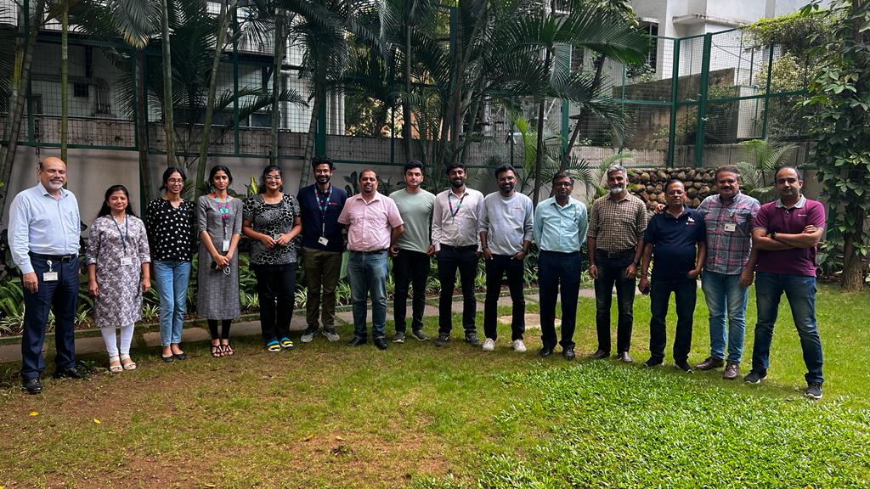
Workshops
EVENTS
Design Thinking workshop at Bosch Learning Campus.
Team half-yearly workshop at Bosch Guest House, Mid Ford Garden.

Slide 13
Skills Learnt
LEARNING OUTCOMES
Soft skills – Improved mindset, broadened perspective, communication
Technical Skills – Power BI

Slide 14
Concept for predictive analysis in shipment delays proved possible using Machine Learning and Power BI. The prototype has been designed with a simple User Interface for a good experience.

Slide 15
ACKNOWLEDGEMENT
I would like to thank Sandesh Pathappa for his constant guidance and encouragement which was extremely required for the development of this project.
I would also like to thank Santhosh Kumar and DT team for their valuable suggestions and timely support.
And thanks to the friendly environment and people which made me give my best results.
Finally, this internship could not have been completed without the encouragement and support from my family and friends.

Slide 16
From a bud, she proceeds to grow into a rose amidst all the thorns. Hope this prototype grows into a rose too. ~Minal Raghu

Slide 17
THANK YOU

